Slide 1
SOFTWARE PROCESS MODELS
Mehwish Mumtaz

Slide 2
What Do We Mean by a Process?
Is a series of steps involving activities, constraints, and resources to produce an intended output
Prepare for exams
Conduct a software competition
Organize a trip
Write a term project report
Involves a set of tools and techniques
Block diagrams
Notations

Slide 3
How is a Process Useful?
Impose consistency and structure on a set of activities
Guide us to understand, control, examine, and improve the activities
Enable us to capture our experiences and pass them along

Slide 4
Characteristics of a Process
Prescribes all major process activities
Uses resources, subject to set of constraints (such as schedule)
Produces intermediate and final products
May be composed of sub-processes with hierarchy or links
Each process activity has entry and exit criteria
Activities are organized in sequence, so timing is clear
Each process guiding principles, including goals of each activity
Constraints may apply to an activity, resource or product

Slide 5
Software Lifecycle
When a process involves building a software (product), the process may be referred to as software (product) lifecycle
Requirements analysis and definition
System (architecture) design
Program (detailed/procedural) design
Writing programs (coding/implementation)
Testing: unit, integration, system
System delivery (deployment)
Maintenance

Slide 6
What is a Process Model?
Description of a process, evolved overtime, in a certain format
May use text, pictures, or a combination
Contains key process features

Slide 7
Why is a Process Model Needed?
To form a common understanding
To find inconsistencies, redundancies, omissions
To find and evaluate appropriate activities for reaching process goals
To tailor a general process for a particular situation in which it will be used

Slide 8
Nature of Software Process Model?
Models that prescribe how should development of software progress
Models that describe how is software developed in actuality

Slide 9
Framework Activities
Communication
customer, other stakeholders
Planning
Roadmap, project plan
Modeling
Understanding requirements, provide design
Construction
Code generation, testing
Deployment
Delivery to customer, feedback and evaluation

Slide 10
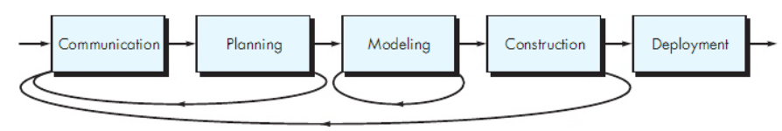
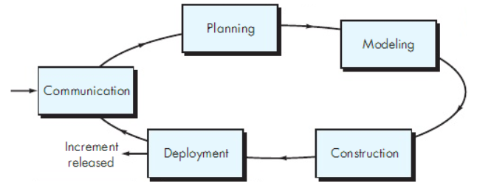
Process Flow

Slide 11
Software Development Process Models
Waterfall model
Classical
With prototyping
V model
Prototyping model
Phased development: increments and iterations
Spiral model
Unified process
Rapid Application Development (RAD)
Agile methods
XP
Scrum
Kanban

Slide 12
Waterfall Model
One of the first process development models proposed
Works for well understood problems with minimal or no changes in the requirements
Simple and easy to explain to customers
It presents
a very high-level view of the development process
sequence of process activities
Each major phase is marked by milestones and deliverables (artefacts)

Slide 13
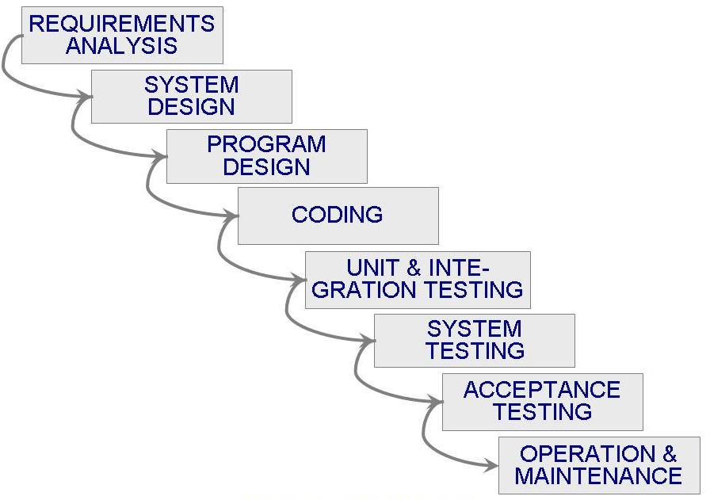
Waterfall Model (Contd.)

Slide 14
Waterfall Model (Contd.)
Provides no guidance how to handle changes to products and activities during development (assumes requirements can be frozen)
Views software development as manufacturing process rather than as building process
There are no iterative activities that lead to building a final product
Long wait before a final product
Generates lots of documentation
Considered suitable for large projects

Slide 15
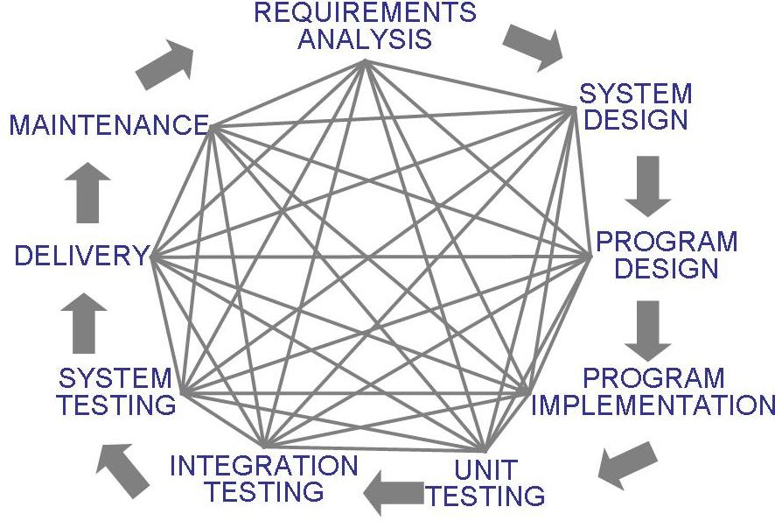
Waterfall Model (Contd.)
Uncontrolled Software Development Process
No Iterations in WF?
Loop: Problem Definition, Technical Design and Development, Integration, Operations and Maintenance
Notes:
Loop: Problem Definition, Technical Design and Development, Integration, Operations and Maintenance

Slide 16
Waterfall Model with Prototyping
A prototype is a partially developed product
Prototyping helps
developers assess alternative design strategies (design prototype)
users understand what the system will be like (user interface prototype)

Slide 17
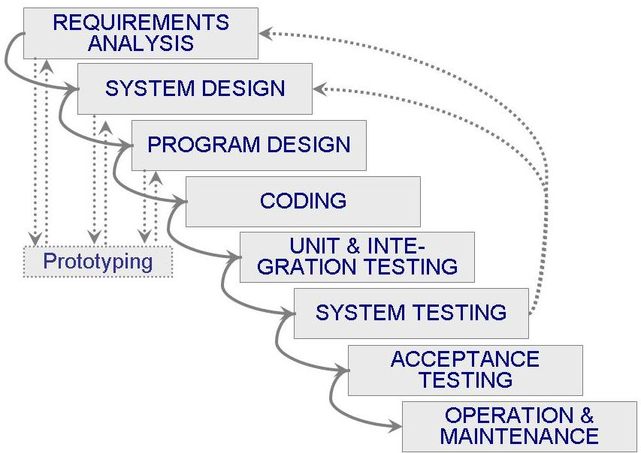
Waterfall Model with Prototyping

Slide 18
V Model
A variant of the waterfall model
Uses unit testing to verify procedural design
Uses integration testing to verify architectural (system) design
Uses acceptance testing to validate the requirements
If problems are found during verification and validation, the left side of the V can be re-executed before testing on the right side is re-enacted
Verification: Each function works correctly
Validation: All requirements have been implemented and each functionality can be traced back to a particular requirement

Slide 19
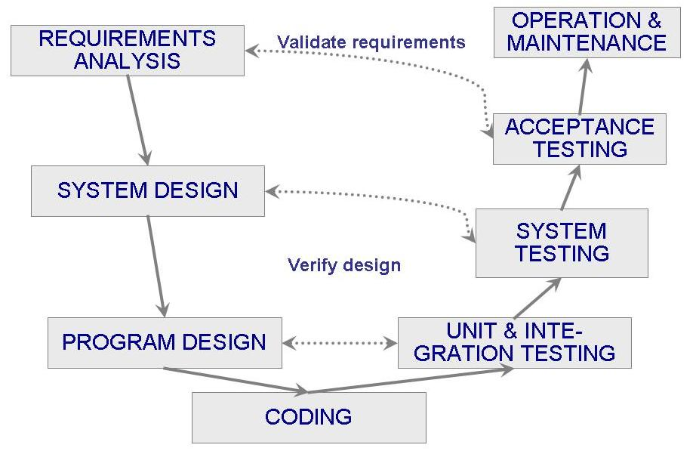
V Model (Contd.)

Slide 20
Phased Development
Cycle time
Time between when requirements document was written and when the system was delivered
Shorter cycle time
Decomposed system
System delivered in pieces
enables customers to have some functionality while the rest is being developed
Two systems functioning in parallel
the production system (release n): currently being used
the development system (release n+1): the next version

Slide 21
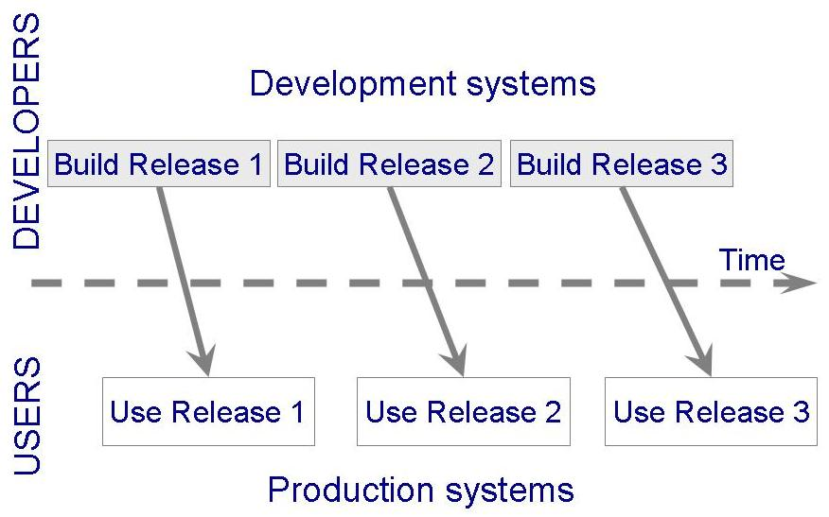
Phased Development (Contd.)

Slide 22
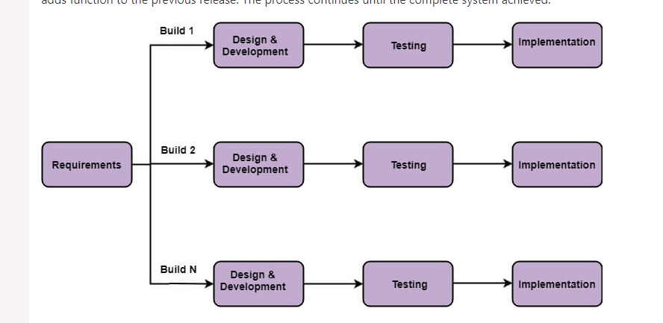
Incremental(Iterative) Model
Basic Requirements
Customer use the first release
Modification in the first release
Useful when staffing is unavailable

Slide 23
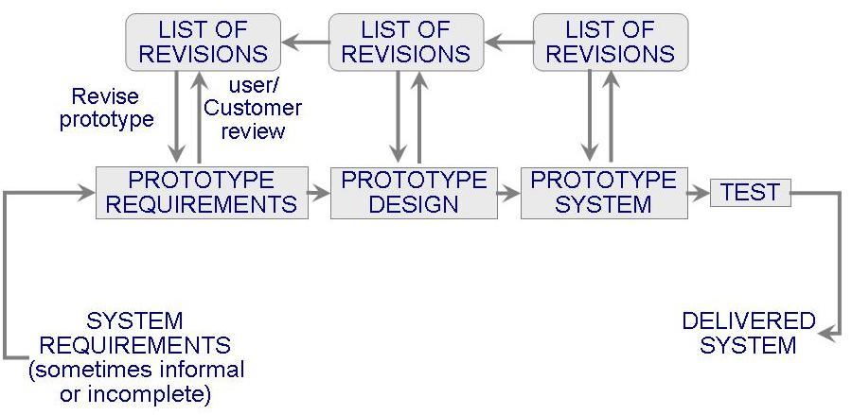
Prototyping Model
Allows repeated investigation of the requirements or design
Reduces risk and uncertainty in the development

Slide 24
Prototyping Model (Contd.)

Slide 25
Prototyping Model (Contd.)
RAPID (THROWAWAY) PROTOTYPING
Its name refers to the ease and speed with which a prototype can be modified to try different ideas with the user audience and incorporate their feedback.
EVOLUTIONARY PROTOTYPING
An evolutionary prototype differs from the traditional notion of a software prototype; an evolutionary prototype is a functional piece of software, not just a simulation.

Slide 26
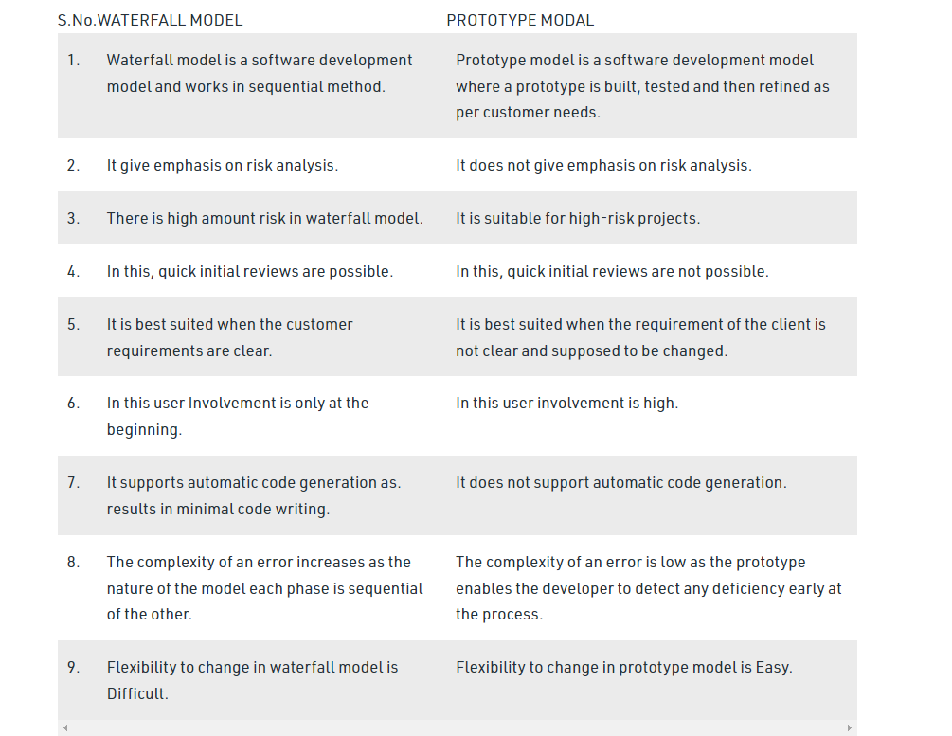
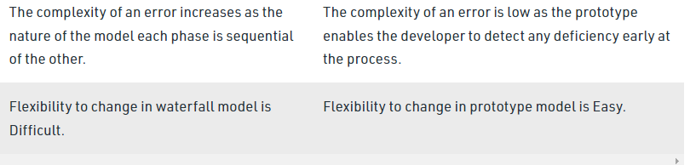
Waterfall vs Prototype

Slide 27
Spiral Model
Suggested by Boehm (1988)
Combines development activities with risk management to minimize and control risks
The model is presented as a spiral in which each iteration is represented by a circuit around four major activities
Plan
Determine goals, alternatives and constraints
Evaluate alternatives and risks
Develop and test

Slide 28
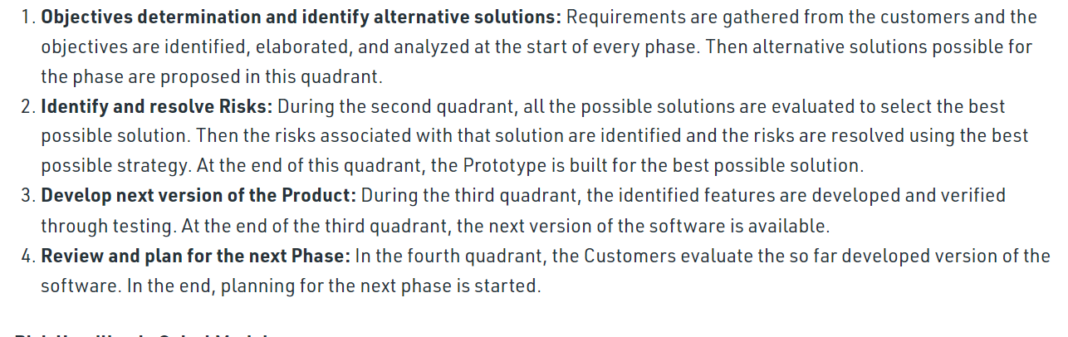
Spiral Model (Contd.)

Slide 29
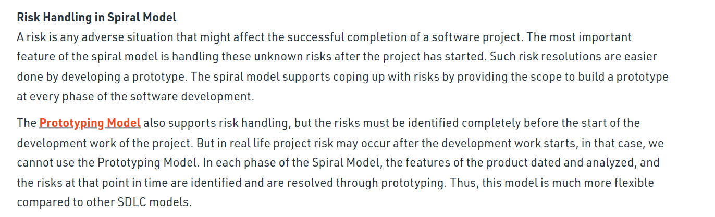
Spiral Model (Contd.)

Slide 30
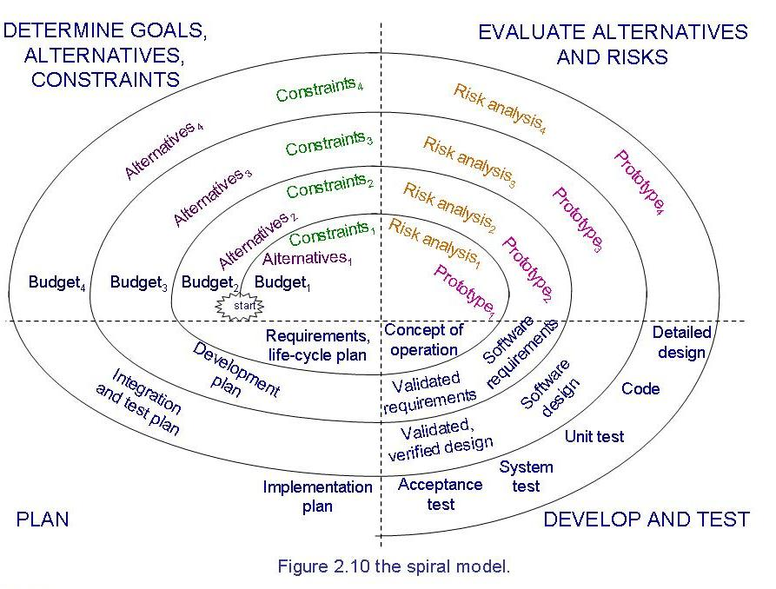
Spiral Model (Contd.)

Slide 31
Spiral Model (Contd.)
Difficult to convince customers to use evolutionary approach-

Slide 32
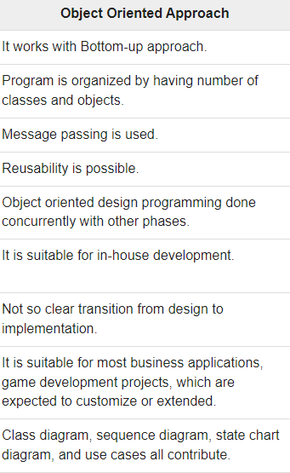
Unified Process Model

Slide 33
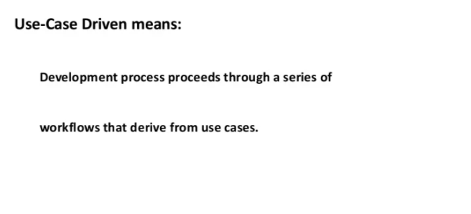
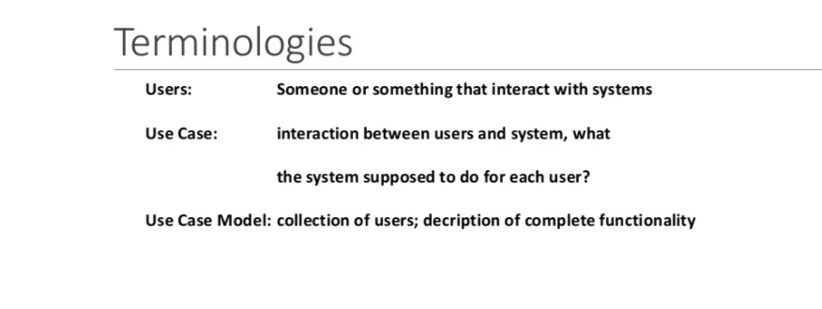
Unified Process Model

Slide 34
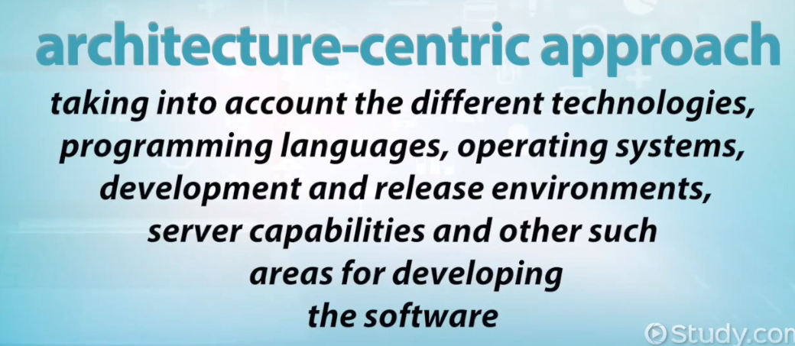
Unified Process Model

Slide 35
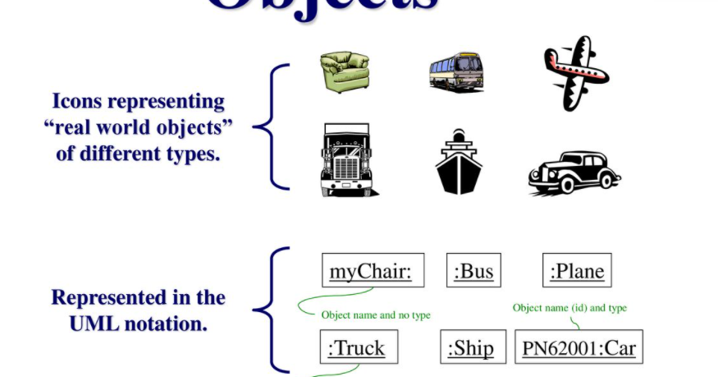
Unified Process Model
Object Oriented Approach
Object:
For example, in the case of a Banking System, a customer is an object, a cheque book is an object, and even an account is an object.

Slide 36
Unified Process Model
Object:
Real-world objects share two characteristics: They all have state(attribute) and behavior. Dogs have state (name, color, breed) and behavior (barking, fetching, wagging tail). Bicycles also have state (current gear, current pedal, current speed) and behavior (changing gear, changing pedal cadence, applying brakes). Identifying the state and behavior for real-world objects is a great way to begin thinking in terms of object-oriented programming.
OR
An object is something that is exists within problem domain and can be identified by data (attribute) or behavior. All tangible entities (student, patient) and some intangible entities (bank account) are
modeled as object.
Software objects are conceptually similar to real-world objects: they too consist of state and related behavior. An object stores its state in fields (variables in some programming languages) and exposes its behavior through methods (functions in some programming languages)

Slide 37
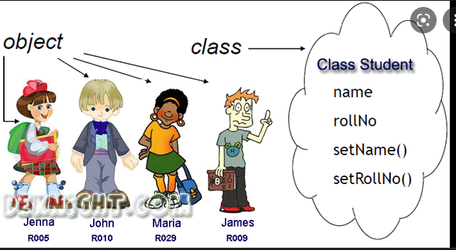
Unified Process Model (Object)

Slide 38
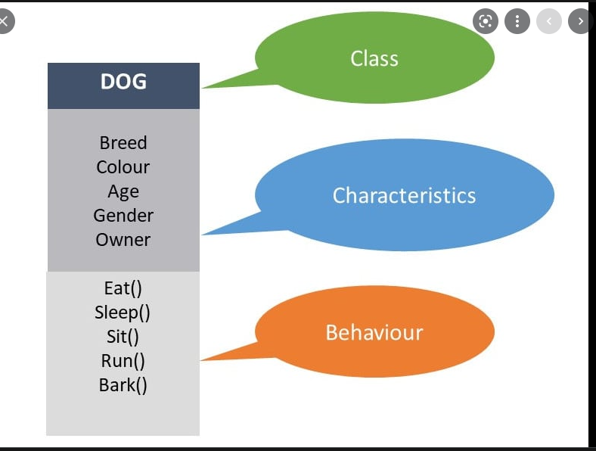
Unified Process Model (Class)

Slide 39
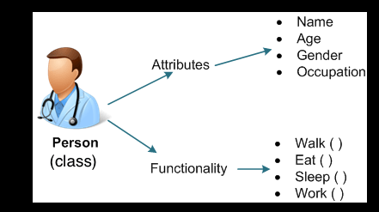
Unified Process Model (Class)

Slide 40
Unified Process Model
Object-oriented system development methodology Offered by Rational/IBM, UP developed by Booch, Rumbaugh, and Jacobson
UP should be tailored to organizational and project needs
Highly iterative life cycle
use-case driven(looking through user perspective).
Risk Focused

Slide 41
Unified Process Model (Contd.)
Four Phases:
Inception – develop and refine system vision
Elaboration – define requirements and design and implement core architecture
Construction – continue design and implementation of routine, less risky parts
Transition – move the system into operational mode

Slide 42
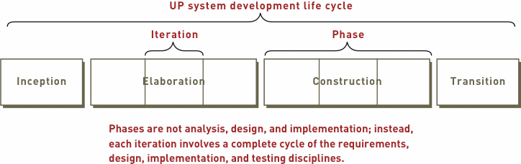
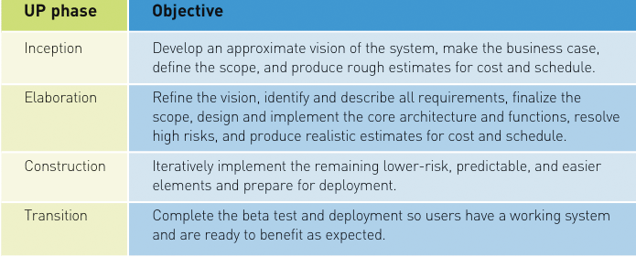
Unified Process Model (Contd.)
Images’ Source: Systems Analysis and Design in a Changing World, 4th Edition

Slide 43
Unified Process Model (Contd.)
Related development activities are called disciplines
UP disciplines:
Business modeling, requirements, design, implementation, testing, deployment, project management, configuration and change management, and environment
Each iteration includes activities from all disciplines
Activities in each discipline produce artefacts – models, documents, source code, and executables

Slide 44
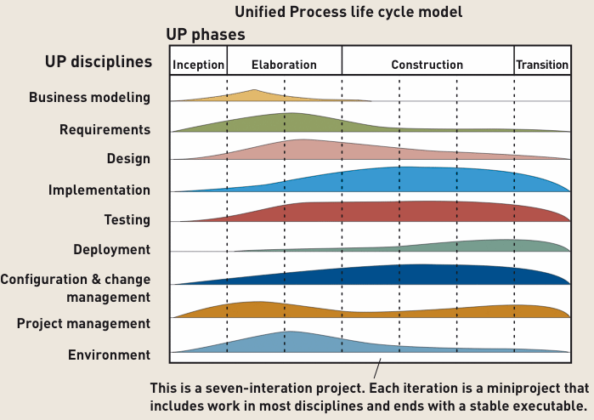
Unified Process Model (Contd.)
Image Source: Systems Analysis and Design in a Changing World, 4th Edition

Slide 45
Agile Methods
Emphasis on flexibility in producing software quickly and capably in rapidly changing environment
Market condition
End-user needs
Competitive threats
Agile Methods, Chapter 05, SE Book by Pressman et al.

Slide 46
Agile Methods
Assumptions to be addressed:
Which requirements will persist/change? How will the customer priorities change?
The extent/amount of design work before coding and testing?
Planning of all engineering activities?
Adaptable?
Incremental
Customer feedback
Portion of an operational system
Unpredictability

Slide 47
Agile Methods
Agile manifesto
Concentrate on responding to change rather than on creating a plan and then following it
Value individuals and interactions over process and tools
Prefer to invest time in producing working software rather than in producing comprehensive documentation
Focus on customer collaboration rather than contract negotiation

Slide 48
Agile Methods

Slide 49
Agile Methods

Slide 50
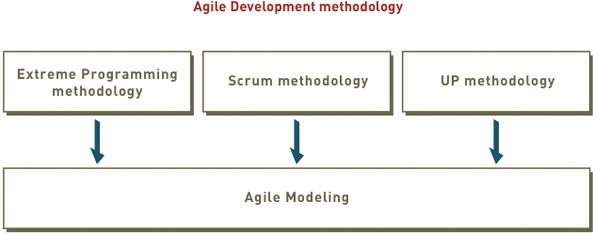
Agile Methods (Contd.)

Slide 51
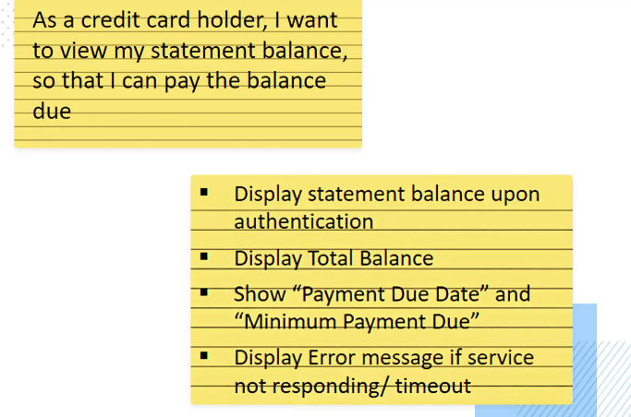
Agile Methods (Contd.)
Extreme Programming (XP)
User Story
14- days cycle

Slide 52
Agile Methods (Contd.)
Phases of Extreme programming:
There are 6 phases available in Agile XP method, and those are explained as follows:
Planning
Identification of stakeholders and sponsors
Infrastructure Requirements
Security related information and gathering
Service Level Agreements and its conditions
Analysis
Capturing of Stories in Parking lot
Prioritize stories in Parking lot
Scrubbing of stories for estimation
Define Iteration SPAN(Time)
Resource planning for both Development and QA teams
Design
Break down of tasks
Test Scenario preparation for each task
Regression Automation Framework

Slide 53
Agile Methods (Contd.)
Phases of eXtreme programming:
Execution
Coding
Unit Testing
Execution of Manual test scenarios
Defect Report generation
Conversion of Manual to Automation regression test cases
Mid Iteration review
End of Iteration review
Wrapping
Small Releases
Regression Testing
Demos and reviews
Develop new stories based on the need
Process Improvements based on end of iteration review comments
Closure
Pilot Launch
Training
Production Launch

Slide 54
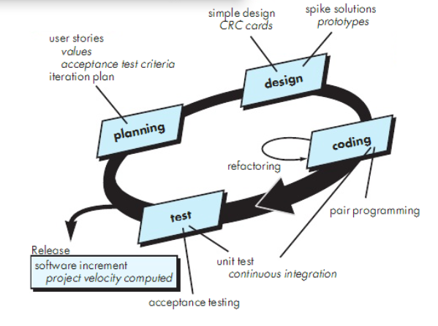
Agile Methods (Contd.)

Slide 55
Agile Methods (Contd.)
Scrum:
A quick, adaptive, and self-organizing development methodology
Responds to a current situation as rapidly and positively as possible

Slide 56
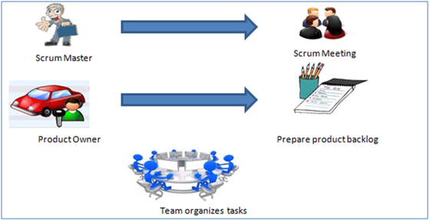
Agile Methods (Contd.)
SCRUM is an agile development method which concentrates specifically on how to manage tasks within a team-based development environment.
Scrum believes in empowering the development team and advocates working in small teams (say- 7 to 9 members). It consists of three roles, and their responsibilities are explained as follows

Slide 57
Agile Methods (Contd.)
Scrum Master
Master is responsible for setting up the team, sprint meeting and removes obstacles to progress
Product owner
The Product Owner creates product backlog, prioritizes the backlog and is responsible for the delivery of the functionality at each iteration
A product backlog is a list of the new features, changes to existing features, bug fixes, infrastructure changes or other activities that a team may deliver in order to achieve a specific outcome.
Scrum Team
Team manages its own work and organizes the work to complete the sprint or cycle

Slide 58
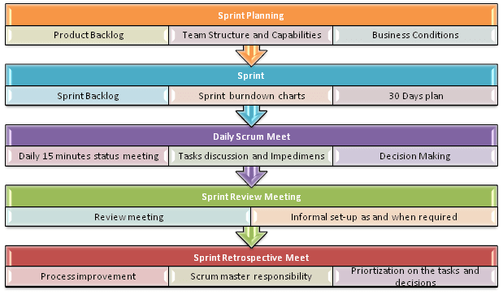
Agile Methods (Contd.)
Scrum Practices
Practices are described in detailed:

Slide 59
Agile Methods (Contd.)
Scrum Philosophy
Responsive to a highly changing, dynamic environment
Focuses primarily on the team level
Team exerts total control over its own organization and work processes
Uses a product backlog as the basic control mechanism
Prioritized list of user requirements used to choose work to be done during a Scrum project

Slide 60
Agile Methods (Contd.)
Process flow of Scrum Methodologies:
Process flow of scrum testing is as follows:
Each iteration of a scrum is known as Sprint
Product backlog is a list where all details are entered to get the end-product
During each Sprint, top user stories of Product backlog are selected and turned into Sprint backlog
Team works on the defined sprint backlog
Team checks for the daily work
At the end of the sprint, team delivers product functionality

Slide 61
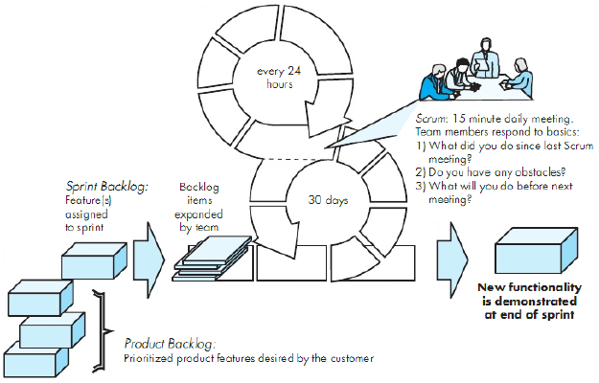
Scrum Process Flow

Slide 62
RAD Rapid Application Development Model
Focuses on short development Life Cycle 60-90 days Project
Linear Sequential Model
Multiple Teams working on the modules
Customer involves throughout the life cycle
Improve Productivity multiple teams involve
Not recommended when risk is high
Sufficient human resources require
Development team and Client continuously involve in rapid fire activities

Slide 63
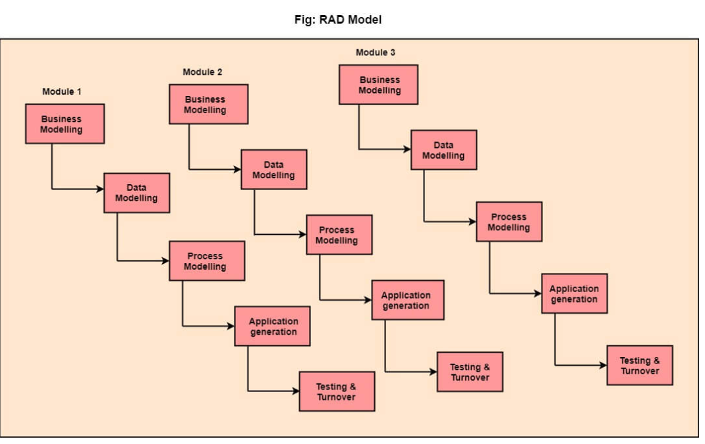
RAD Rapid Application Development Model

Slide 64
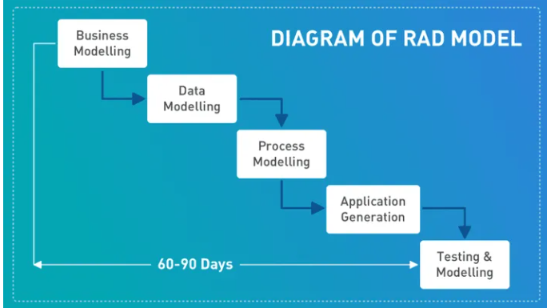
RAD Rapid Application Development Model

Slide 65
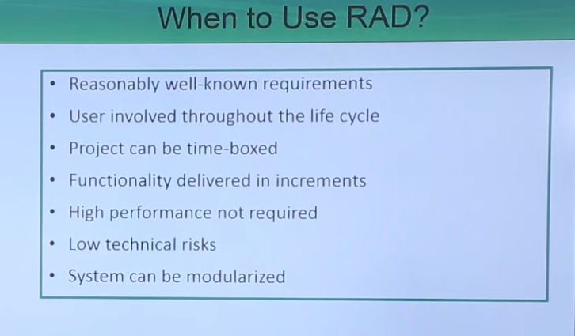
RAD Rapid Application Development Model

Slide 66
RAD Rapid Application Development Model
The Difference between RAD Model and Agile Model
Unlike the Waterfall approach, RAD focuses on processes rather than design. RAD uses existing code and proven processes to create new software prototypes.
This makes the Rapid Application Development model a versatile, adaptable, and time-saving option for software developers and web applications.
The Rapid Application Development model is best suited in scenarios that require the development of new applications within a span of two to three months.
However, one must keep in mind that, to develop anything on a RAD platform, the requirements must be well defined.

Slide 67
RAD Rapid Application Development Model
The Difference between RAD Model and Agile Model
Agile recognizes that software projects are fundamentally unpredictable and that there are likely to be changes over the course of the project. These changes, be it market changes or feature changes as the product comes to life will need to be addressed. agile welcomes this volatility by breaking down projects into small chunks called sprints, to facilitate prioritization and allowing engineers to add or drop features during the project.

Slide 68
RAD Rapid Application Development Model
Business Modeling – In business modeling, identification of flow of information is done and is been modeled between different functions of the business. It simply describes how your business will result in payable check that means to make money and explains how you will add value or increase quality of product and deliver valued product to customers at an appropriate cost. In this phase, business functions and product scope are decided during various meetings between the requirements planning team and the client team The following information is collected by business functions:
Information that drives business process that means information gathered during development and before development required for increasing quality so as to develop successful business.
Type of information being generated during modeling about overall development result so that if there is any change or modification required, it can be done to increase quality.
Generator of information who generates or makes information.
Flow of information or direction of flow about how information is transferring so that if there is an issue, it can be resolved.
Processor of the information who processes identified information and makes changes if required.

Slide 69
RAD Rapid Application Development Model
2.Data Modeling – for defining requirements In this phase, information collected in business model is classified on basis of different categories and used to define data objects that are available. The characteristics of all data objects that are present are identified that are useful in development of business. Between different data objects, relationship is present that connects them which is defined or explained in this type of modeling.
The information flow defined as part of the business modeling phase is refined into a set of data objects that are needed to support the business. The characteristics (called attributes) of each object are identified and the relationships between these objects defined.
3. Process Modeling – In this phase, data objects that are necessary are transformed or converted into required usable information or processes. These processes are very important as they help to extract or gain information from data objects so as to make any change required for proper processing without any issue and are responsible for implementing business functions. During this stage, changes and optimization in project development can be done as per requirement to increase value and quality
In this phase, all the data objects gathered in the process modeling phase are transformed into required useful information.

Slide 70
RAD Rapid Application Development Model
Application Generation – In this stage, the actual prototype is developed using different automated CASE tools.
For creating or developing software, different automation tools can be used. To have an increase in development of software very fastly to reduce development time, RAD makes use of components that are reusable or develops reusable components if not available.
Testing and Turnover – In this stage, all the modules and interfaces of the prototype are tested.
AD uses reusable components so that efforts that are required for testing are reduced. But during software development, if new components are added in process during testing, then testing such new added components is must and essential so that if any error found it can be removed. The testing of all interfaces is equally important to be on safe side of project development without any error.

Slide 71
References
SE, Pressman
SE, Pfleeger
Acknowledgement
A few slides have been adapted from UCF slides for the SE course

